Slide 1





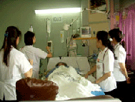



รักษ์หัวใจในที่ทำงาน
หัวใจ & บุหรี่
ผศ.นพ.สุทัศน์ รุ่งเรืองหิรัญญา, FCCP
หน่วยโรคทางเดินหายใจและเวชบำบัดวิกฤต
ภาควิชาอายุรศาสตร์
คณะแพทยศาสตร์ มศว.

Slide 2

Notes:
รักสามเส้า เหมือน วนิดา กับ พิสมัย และประจักษ์

Slide 3
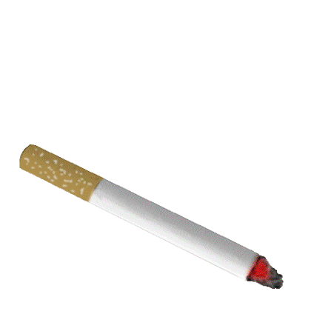
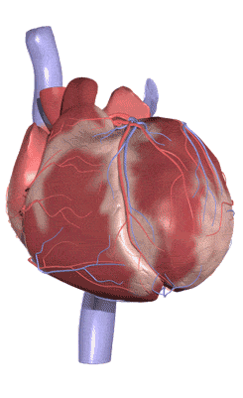

คุณมี “หัวใจ” กันคนละกี่ดวง?

Slide 4

โรคหัวใจ...อยู่ใกล้คนไทยมากขึ้นเรื่อยๆ
ทุกชั่วโมง คนไทยตายจากโรคนี้ 4 คนหรือวันละ 96 คน และมีแนวโน้มเพิ่มขึ้น
คนไทยตายจากหัวใจขาดเลือด เพิ่มขึ้นเรื่อยๆ
ปี 2542 =7.9 ต่อแสนราย
ปี 2551 = 21.2 ต่อแสนราย

Slide 5

สาเหตุของโรคหัวใจ
สูบบุหรี่
เบาหวาน
ความดันโลหิตสูง
อ้วนลงพุง

Slide 6
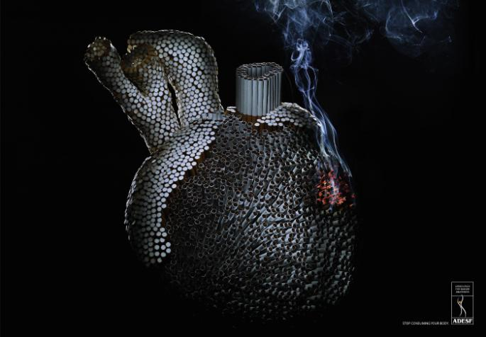
บุหรี่
ตีบ ตัน แตก ตาย

Slide 7
บุหรี่...เพิ่มความเสี่ยงต่อโรคหลอดเลือดหัวใจ
ตีบ ตัน
การสูบบุหรี่เพิ่มความเสี่ยง ในการเกิดโรคนี้อย่างน้อย 3 เท่า
10
9
8
7
6
ความเสี่ยง (95% CI)ª
5
4
3
2
1
0
Age <40 y
Age 40-49 y
Age 50-59 y
Age 60-69 y
Age >70 y
Nonsmokers
Ex-smokers
1-19
≥20
ª.Teo. Lancet. 2006;368:647-658.

Slide 8
บุหรี่ มีผลต่อ โรคหลอดเลือดหัวใจ
ยิ่งสูบมาก
ความเสี่ยง ยิ่งมาก
ความเสี่ยง
1-14 /วัน
15-24 / วัน
≥ 25 / วัน
ไม่สูบเลย
Cigarettes/Day
ª The probability of an event (developing a disease) occurring in exposed people compared with the probability of the event in nonexposed people. Adjusted for age.
Willett et al. N Engl J Med. 1987;317(21):1303-1309.
Notes:
Key Point
The risk of fatal CAD may be directly related to the amount smoked.
Willett et al prospectively evaluated the incidence of CAD in a cohort of 119,404 female nurses enrolled in the Nurses’ Health Study. Participants completed questionnaires at baseline (1976) and were followed up over a 6-year period. Smoking status was identified. Deaths among nonrespondents were identified through searches of state records and the National Death Index or were reported by family members. More than 98% of the deaths were identified. Fatal CAD was defined as fatal myocardial infarction (MI) confirmed by hospital records or at autopsy, or as CAD recorded on the death certificate, if this was the only cause given and there was previous evidence of CAD.
Compared with nonsmokers, the age-adjusted relative risk (RR) of fatal CAD, increased with increasing daily cigarette use: 1.7, 3.7, and 5.4, for 1-14/day, 15-24/day, and ≥25/day, respectively.
Reference
Willett WC, Green A, Stampfer MJ, et al. Relative and absolute excess risks of coronary heart disease among women who smoke cigarettes. N Engl J Med. 1987;317(21):1303-1309.

Slide 9
บุหรี่ มีผลต่อทั้งรอยโรคเก่าและใหม่
Progression of Existing Lesions
Formation of New Lesions
57
P=.002
P=.007
37
36
Patients (%)
Patients (%)
20
Waters et al. Circulation. 1996;94:614-621.

Slide 10
บุหรี่ เพิ่มความเสี่ยงต่อการตายจากโรคหัวใจขาดเลือด
Relative Risk (95% CI)ª
ªThe probability of an event (developing a disease) occurring in exposed people compared with the probability of the event in nonexposed people. Adjusted for age.
Wannamethee et al. Circulation. 1995;91:1749-1756.
Notes:
Key Point
Current smoking is associated with an increased risk of sudden cardiac death.
Wannamethee et al prospectively evaluated 7735 British men, aged 40 to 59 years from the British Regional Heart Study (BRHS). All participants completed questionnaires regarding their smoking habits, alcohol intake, and medical history. Subjects had complete physical exams that included fasting bloodwork, pulmonary function tests (PFTs), and ECG.
Participants were followed up for 8 years. Fatal events were defined as death from ischemic heart disease. Sudden cardiac death was defined as an event in which death occurred within 1 hour after the onset of symptoms. Only those men for whom clear information was available about their death within 1 hour were included in the category of sudden death.
A Cox proportional hazards model was used to evaluate contribution of risk factors to the risk of sudden cardiac death and to derive the age-adjusted RRs.
When adjusted for age, current smokers had an increased risk of sudden cardiac death (RR, 2.3, 95% CI, 1.2-4.0).
Reference
Wannamethee G, Shaper AG, Macfarlane PW, Walker M. Risk factors for sudden cardiac death in middle-aged British men. Circulation. 1995;91:1749-1756.

Slide 11
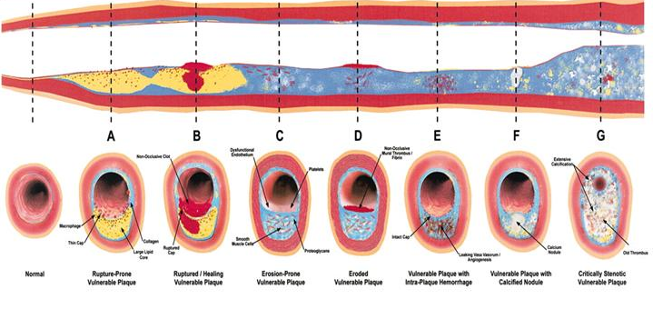
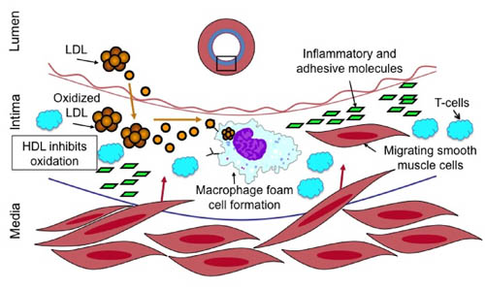
กลไกการตีบของหลอดเลือด

Slide 12
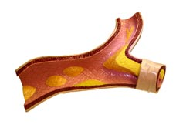
บุหรี่ ทำให้หลอดเลือดหัวใจตีบได้อย่างไร
Endothelial dysfunction
↑inflammatory response
↑thrombogenicity
↑oxidative modification

Slide 13
Endothelial Dysfunction
Flow-dependent dilation was significantly blunted in current
smokers compared with nonsmokers
Angiographically normal nonsmokers
Angiographically irregular nonsmokers
Angiographically normal smokers
P<.01
Angiographically irregular smokers
P<.001
60
P<.01
P<.01
50
40
P<.01
Flow-Dependent Dilation (%)
30
20
10
0
–10
Nonsmokers
Current Smokers
Zeiher et al. Circulation. 1995;92:1094-1100.

Slide 14
Current smokers มีโอกาสเกิด endothelial dysfunction มากกว่า nonsmokers
60
P=.03
46%
45
35%
34%
Endothelial Dysfunction (%)
30
15
0
Nonsmokers
Ex-smokers
Current
Smokers
Lavi et al. Circulation. 2007;115:2621-2627.

Slide 15
↑thrombogenicity
Tissue factor (TF) is highly expressed in atherosclerotic plaques and may play a role in thrombosis
assessed by factor Xa
Smoking raise TF levels
P=.003
Factor Xa (FXa) pmol/L/min
Sambola et al. Circulation. 2003;107:973-977.

Slide 16
Smoking raise inflammation
↑WBC Count
P<.0001
Nonsmokers
8
Ex-smokers
Current Smokers
6
P=.03
Cell Counts (10⁹/L)
4
P<.0001
2
P<.0001
0
WBC
Neutrophils
Lymphocytes
Monocytes
Lavi et al. Circulation. 2007;115:2621-2627; Stewart et al. Circulation. 2005;111:1756-1762
Notes:
Key Point
Current smokers without evidence of significant coronary artery disease have significantly increased WBC counts compared with nonsmokers.
Elevated WBC counts have been associated with a greater long-term cardiovascular risk. In an attempt to establish whether or not smoking is associated with coronary endothelial dysfunction and inflammation, Lavi et al evaluated 881 patients referred for evaluation of chest pain, who did not have evidence of significant coronary artery disease on diagnostic coronary angiography. Patients consisted of 115 current smokers (smoking within the last month) and 766 ex-smokers and nonsmokers. Nonsmokers included both previous and never smokers.
All patients underwent diagnostic coronary angiography. Microvascular coronary flow reserve was assessed after infusion with incremental doses of adenosine. Coronary vasoreactivity was assessed after infusion of incremental doses of acetylcholine. Endothelium-independent epicardial coronary artery function was assessed by the change in coronary artery diameter in response to an intracoronary bolus of nitroglycerine. All patients had baseline bloodwork prior to angiography to evaluate WBC count and other systemic markers of inflammation.
Both total WBC count and leukocyte subtypes were higher in current smokers than in nonsmokers.
References
Stewart R, White H, Kirby A; et al; The Long-term Intervention With Pravastatin in Ischemic Disease (LIPID) Study Investigators. White blood cell count predicts reduction in coronary heart disease mortality with pravastatin. Circulation. 2005;111:1756-1762.
Lavi S, Prasad A, Yang E, et al. Smoking is associated with epicardial coronary endothelial dysfunction and elevated white blood cell count in patients with chest pain and early coronary artery disease. Circulation. 2007; 115:2621-2627.

Slide 17
Smoking ↑risk of oxidative injury
↓Nitric Oxide (NO) Biosynthesis
5000
P<.0001
4000
3613
3000
NO Concentration (nmol/L)
2000
1266
1000
0
Nonsmokers
Current Smokers
Barua et al. Circulation. 2001;104:1905-1910.
Notes:
Key Point
Smoking is associated with reduced nitric oxide (NO) biosynthesis.
NO is the primary vasodilatory substance produced by endothelial cells. Smokers have been noted to have impaired endothelium-dependent vasodilation (EDV). Barua et al hypothesized that reduction in NO biosynthesis contributes to the impaired EDV noted in current smokers.
Twenty-three male patients (15 current smokers, 8 nonsmokers) had fasting bloodwork drawn, while abstaining from smoking for a 6 to 8 hour period. Human umbilical vein endothelial cells (HUVECs) were incubated with serum from participants, and after 12 hours basal NO production in the supernatant was determined. NO production in the cell culture supernatant was evaluated by chemiluminscence.
HUVECs incubated with current smoker’s serum showed significantly lower basal NO production compared with HUVECs incubated with nonsmoker’s serum (P<.0001).
The authors concluded that smoking is associated with reduced basal NO production.
Reference
Barua R, Ambrose JA, Eales-Reynolds LJ, DeVoe MC, Zervas JG, Saha DC. Dysfunctional endothelial nitric oxide biosynthesis in healthy smokers with impaired endothelium-dependent vasodilatation. Circulation. 2001;104: 1905-1010.

Slide 18
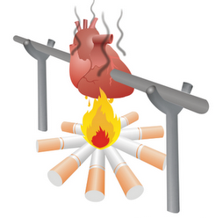
บุหรี่เพียงอย่างเดียวก็สามารถทำลาย
หัวใจดวงน้อยๆได้สบายๆ
↑inflammatory response
Endothelial dysfunction
↑oxidative modification
↑thrombogenicity

Slide 19
หากมีปัจจัยเสี่ยงอื่นๆร่วมด้วย...
Rates per 1000ª
No Risk
Factors
Smoking,
Cholesterol,
or HTN alone
Smoking +
Cholesterol
or HTN
Cholesterol
+ HTN
All 3 Risk
Factors
Risk Factor Status at Entry Into the Study
ª All rates were age-adjusted by 10-year age groups to the US white male population in 1980. Hypercholesterolemia defined as cholesterol ≥250 mg/dL. Hypertension defined as a diastolic blood pressure ≥90 mm Hg. Burns. Prog Cardiovasc Dis. 2003;46(1): 11-29; Source: Pooling Project Research Group, 1978.
Notes:
Key Point
Smoking has a multiplicative interaction with the major risk factors for coronary artery disease (CAD), to increase disease risk.
For example, if the presence of smoking alone doubles the level of risk for CAD, the presence of another major risk factor in conjunction with smoking results in approximately a 4-fold (2×2) increase in risk, and the presence of 2 other risk factors together with smoking results in approximately an 8-fold increase in risk (2×2×2).
As shown above, baseline risk of a new cardiac event is 23/1000 (without risk factors present). Presence of any one of the major risk factors increases the risk for a new cardiac event over a 10-year interval to 31/1000. If the presence of each additional risk factor acted independently, then the risk would increase by 31 for 1, by 62 for 2, and by 93 for 3 risk factors. However, as noted above, adding smoking to another risk factor results in markedly higher risk than would have resulted from simply adding together independent risks.
This indicates that smoking interacts with other risk factors to produce a level of risk greater than that of independent risk factors alone.
Reference
Burns DM. Epidemiology of smoking-induced cardiovascular disease. Prog Cardiovasc Dis. 2003;46(1):11-29.

Slide 20
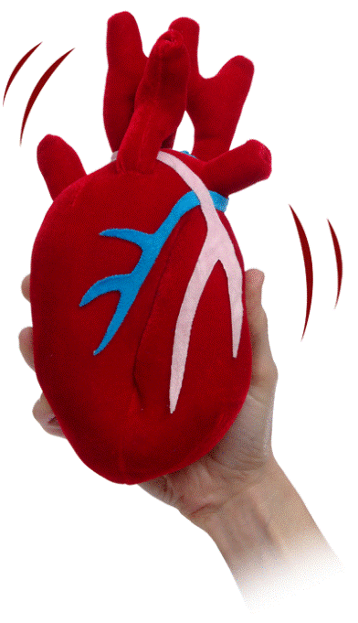
โดยสรุป...บุหรี่ กับ โรคหัวใจขาดเลือด
บุหรี่ เป็นปัจจัยหลัก ที่สำคัญในการเกิดโรค CAD โดยผ่านกลไก
  Endothelial dysfunction
  ↑thrombogenicity
  ↑WBC counts
  ↑oxidative stress
บุหรี่ สามารถร่วมกับปัจจัยเสริมอื่นๆในการเพิ่มความเสี่ยงในการเกิดโรค CAD ได้
บุหรี่ สามารถเพิ่มโอกาสเสียชีวิตจากโรค CAD ได้

Slide 21


หากที่ทำงานไม่ปลอดบุหรี่

Slide 22
ควันมือสอง ↑ความเสี่ยง
โรคหลอดเลือดหัวใจตีบ
การได้รับควันมือสองเพิ่มความเสี่ยงเกิดโรคหัวใจได้ถึง 30%
0.20
สูบไม่จัด
0.15
รับควันมือสองประจำ
สัดส่วนการเกิดโรคหัวใจตีบ
0.10
0.05
รับควันมือสองไม่มาก
0
0
5
10
15
20
จำนวนปีที่ติดตาม
ªLight active refers to men smoking 1-9 cigarettes a day. ^{b}Heavy passive refers to upper three quarters of cotinine concentration combined (0.8 to 14.0 ng/mL). ^{c}Light passive refers to lowest quarter of cotinine concentration among nonsmokers (0-0.07 ng/mL).
Whincup et al. BMJ. 2004;329:200-205.
Notes:
Key Point
Exposure to environmental tobacco smoke increases the risk of heart disease among nonsmokers by 30%.
Whincup et al prospectively evaluated the relationship between environmental tobacco smoke exposure (quantified by serum cotinine levels) and risk of coronary artery disease (CAD) and stroke in 4729 subjects enrolled in the British Regional Heart Study. Participants were male nonsmokers aged 40 to 59 years, initially evaluated from 1978 to 1980. Baseline examination included assessment of blood pressure and nonfasting cholesterol and cotinine levels in addition to a nurse-administered questionnaire, from which data on smoking and medical history were obtained. Men were classified as “current nonsmokers” at baseline if they reported that they did not smoke and had a cotinine concentration <14.1 ng/mL. Nonsmokers were further subclassified into light and heavy passive smokers. Light passive smokers were nonsmokers who had the lowest levels of cotinine concentration (0-0.7). Heavy passive smokers were nonsmokers who had the highest cotinine concentration (0.8 to 14.0). Light active smokers were men who reported smoking 1 to 9 cigarettes a day, irrespective of cotinine concentration.
All men were followed up for all-cause mortality and cardiovascular mortality. The graph depicts the Kaplan-Meier plot showing the cumulative proportions of men with major CAD over time among the light active, heavy passive and light passive smokers. Age, systolic blood pressure, diastolic blood pressure, total cholesterol, high-density lipoprotein (HDL) cholesterol, forced expiratory volume in 1 second (FEV₁), height, preexisting CAD, body mass index, triglycerides, WBC, diabetes, physical activity (none, occasional, light, moderate, or more), alcohol intake (none/occasional, light/moderate, heavy), and social class (I, II, III non-manual, III manual, IV, V, and Armed Forces) were fitted as dichotomous variables.
Heavy passive and light passive smokers had the highest incidence of major CAD. Although the groups diverged markedly in the early follow-up period, they remained almost parallel during later years.
The authors concluded that environmental tobacco smoke exposure is associated with an increased risk of CAD of approximately 25% to 30%.
Reference
Whincup PH, Gilg JA, Emberson JR, et al. Passive smoking and risk of coronary heart disease and stroke: prospective study with cotinine measurement. BMJ. 2004;329:200-205.

Slide 23
ควันบุหรี่มือสอง กับ ความเสี่ยงของ AMI
4
Nonsmokers
2
Odds Ratio (95% CI)ª
1
Never
1-7
8-14
15-21
≥22
0.75
การได้รับ ETS (จำนวนชั่วโมง ต่อสัปดาห์)
ªThe ratio of the odds of development of disease in exposed persons to the odds of development of disease in nonexposed persons. Adjusted for age, sex, region, physical activity, and consumption of fruits, vegetables, and alcohol. Adapted from Teo et al. Lancet. 2006;368:647-658.
Notes:
Key Point
Exposure to environmental tobacco smoke increased the risk of nonfatal acute (MI) in a graded manner.
Teo et al evaluated 12,133 cases of first acute MI and 14,435 age-matched and sex-matched controls in the international, multicenter INTERHEART study. Trained staff administered a questionnaire to both cases and controls in which participants were asked detailed questions about their smoking status.
After adjusting for age, sex, region, physical activity, and consumption of fruits, vegetables, and alcohol, nonsmokers who had no previous environmental tobacco smoke exposure showed increasing risk of nonfatal acute MI with increasing levels of exposure to environmental tobacco smoke. Although the etiology is unclear, this increase in risk was slightly attenuated in subjects with ≥22 hours per week of environmental tobacco smoke exposure.
Reference
Teo KK, Ounpuu S, Hawken S, et al, on behalf of the INTERHEART Study Investigators. Tobacco use and risk of myocardial infarction in 52 countries in the INTERHEART study: a case-control study. Lancet. 2006;368:647-658.

Slide 24
ETS can reduce
Vascular Endothelial Function
การได้รับควันบุหรี่มือสองทำให้ coronary flow velocity reserve (CFVR) ลดลงได้แม้ไม่สูบเอง
P<.001
CFVR (Mean ±SD)
Before Acute Exposure
After Acute Exposure
Otsuka et al. JAMA. 2001;286:436-441.
Notes:
Key Point
Exposure to environmental tobacco smoke significantly reduces mean coronary flow velocity reserve (CFVR) in nonsmokers.
To elucidate the effect of environmental tobacco smoke on the coronary circulation, Otsuka et al evaluated CFVR, a measure of endothelial function in the coronary circulation, in 30 male subjects (15 current smokers and 15 nonsmokers).
Subjects had no history of hypertension, diabetes mellitus, hyperlipidemia, or left ventricular hypertrophy. Subjects were considered current smokers if they smoked a minimum of 20 cigarettes/day. Smokers abstained from smoking 12 hours prior to participation in the study.
Coronary flow velocity in the left anterior descending artery was measured by Fourier transformation analysis of Doppler spectral tracings at baseline and at peak hyperemic conditions. CFVR was calculated as the ratio of hyperemic to basal coronary flow velocity. Investigators were blinded to the subject’s smoking status.
In nonsmokers, CFVR was significantly higher than in current smokers at baseline (before acute exposure to environmental tobacco smoke) (P=.02). CFVR in nonsmokers was significantly reduced by acute exposure to environmental tobacco smoke (P<.001).
Reference
Otsuka R, Watanabe H, Hirata K, et al. Acute effects of passive smoking on the coronary circulation in healthy young adults. JAMA. 2001;286(4):436-441.

Slide 25
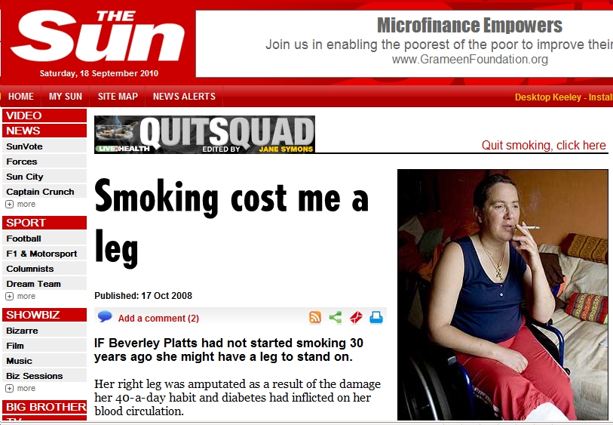
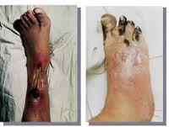
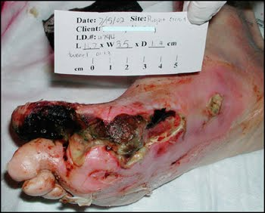

Slide 26
↑Risk of Peripheral Vascular Disease
Odds Ratio (95% CI)ª
Nonsmokers
Ex-smokers
Current Smokers
ªThe ratio of the odds of development of disease in exposed persons to the odds of development of disease in nonexposed persons.
Hooi et al. Scand J Prim Health Care. 1998;16:177-182.
Notes:
Key Point
Smoking is associated with a significantly increased risk of asymptomatic peripheral vascular disease (PVD).
Hooi et al evaluated 3650 residents of the province of Limburg, The Netherlands, in the Limburg Peripheral Arterial Occlusive Disease (PAOD) study. Participants answered a self-administered questionnaire at their doctor’s office, and ankle-brachial pressure index (ABPI) was assessed by means of a pocket Doppler device and a sphygmomanometer. ABPI was calculated as a ratio of the ankle systolic blood pressure to the highest arm systolic blood pressure.
Subjects were considered as having evidence of PVD when a minimum of 1 leg’s resting ABPI was <0.95 on 2 evaluations within a 1-week interval.
Asymptomatic PVD was defined as the combination of an ABPI <0.95 without symptoms of intermittent claudication.
Among study participants, 458 subjects had PVD. One hundred thirty-eight were symptomatic, 314 were asymptomatic, and 6 had unspecified PVD. Current and ex-smoking were significantly associated with asymptomatic PVD, OR 2.8 (1.9-4.0) and 1.6 (1.1-2.4), respectively.
Reference
Hooi J, Stoffers HEJH, Kester A, et al. Risk factors and cardiovascular diseases associated with asymptomatic peripheral arterial occlusive disease: the Limburg PAOD study. Scand J Prim Health Care. 1998;16:177-182.

Slide 27
เมื่อเลิกบุหรี่ โอกาสเกิด AMI ก็ลดลง
4
P<.0001
2
Odds Ratio (95% CI)ª
1
Current
>1-3
>3-5
>5-10
>10-15
>15-20
≥20
Ex-smokers (จำนวนปีหลังเลิกบุหรี่)
ªThe ratio of the odds of development of disease in exposed persons to the odds of development of disease in nonexposed persons. Adjusted for sex, region, diet, alcohol, physical activity, consumption of fruits, vegetables, and alcohol.
Adapted from Teo. Lancet. 2006;368:647-658.
Notes:
Key Point
Risk of acute MI associated with smoking is significantly reduced within a few years of quitting.
Teo et al evaluated 12,461 cases of first acute MI and 14,637 age-matched and sex-matched controls in the international, multicenter INTERHEART study. Trained staff administered a questionnaire to both cases and controls in which participants were asked detailed questions about their smoking status.
Risk of acute MI associated with smoking was markedly reduced within a few years of quitting. Risk of acute MI decreased progressively with time since becoming abstinent; however, some increased risk persisted, even in those who had quit more than 20 years prior.
Reference
Teo KK, Ounpuu S, Hawken S, et al, on behalf of the INTERHEART Study Investigators. Tobacco use and risk of myocardial infarction in 52 countries in the INTERHEART study: a case-control study. Lancet. 2006;368:
647-658.

Slide 28
Benefits of Citywide Smoke-Free Ordinance: ↓Acute MI
27% ↓incidence of acute myocardial infarction (MI) after implementation of a smoke-free ordinance in Pueblo City, Colorado
P<.001
AMI Counts per 100,000
Person-Years
Bartecchi et al. Circulation. 2006;114:1490-1496.
Notes:
Key Point
Enactment of smoke-free ordinances results in significant reductions in hospital admission rates for acute MI.
Bartecchi et al completed an observational study to determine the effects of a citywide smoking ordinance in Pueblo, Colorado, 1.5 years after the enactment of the ordinance. The ordinance prohibited smoking inside the workplace and all buildings open to the public. The study compared acute MI rates in Pueblo City before and after ordinance enactment. The authors also compared acute MI in Pueblo City to rates in El Paso County, Colorado. El Paso County is a geographically isolated community similar to Pueblo that served as an external control because the smoking ordinance was not enacted there.
A 23% reduction in acute MI hospitalizations was observed (RR=0.73; 95% CI, 0.63-0.85) in Pueblo City following the enactment of the ordinance, while there was no significant change in the external control, El Paso County (RR=0.97; 95% CI, 0.89-1.06). There were 257 and 187 acute MI hospitalization counts per 100,000 person years in Pueblo City before and after enactment of the ordinance, respectively. The number of acute MI hospitalizations were significantly reduced after enactment of the ordinance; P<.001.
Reference
Bartecchi C, Alsever RN, Nevin-Woods C, et al. Reduction in the incidence of acute myocardial infarction associated with a citywide smoking ordinance. Circulation. 2006;114;1490-1496.

Slide 29
การเลิกบุหรี่ ลดอัตราตายจาก
การสวนหลอดเลือดหัวใจ
Current smokers had a significantly greater risk of overall mortality after percutaneous coronary revascularization
100
80
60
Survival (%)
40
Quitters
20
Persistent Smokers
0
0
2
3
4
5
6
7
8
9
10
11
12
Years After Index Procedure
Hasdai. N Engl J Med. 1997;336(11):755-761.
Notes:
Key Point
Persistent smokers had a significantly greater risk of overall mortality after percutaneous coronary revascularization.
Patients (N=6600) who underwent percutaneous coronary revascularization at the Mayo Clinic from 1979 through 1995 were followed for up to 16 years by Hasdai et al. Patients were questioned about their smoking status at baseline and follow-up. Study population was divided into 4 groups on the basis of smoking status at baseline: nonsmokers, defined as patients who had never smoked cigarettes regularly; ex-smokers, who had quit smoking a minimum of 6 months before the procedure; quitters, those who had permanently quit smoking immediately after the procedure; and persistent smokers, who smoked before and after the procedure.
The study end points were death from any cause, Q-wave acute myocardial infarction or severe angina, and the need for coronary artery bypass grafting or repeated percutaneous coronary revascularization.
After adjusting for significant differences in baseline variables, risk of death from all causes among persistent smokers was compared with risk among quitters. Persistent smokers had significantly greater risk of overall mortality (RR, 1.44; 95% CI, 1.02-2.11). The estimated survival curves diverged soon after the initial revascularization procedure. The difference between the curves continued to increase throughout the follow-up period.
Reference
Hasdai D, Garratt KN, Grill DE, Lerman A, Holmes DR Jr. Effect of smoking status on the long-term outcome after successful percutaneous coronary revascularization. N Engl J Med. 1997;336(11):755-761.

Slide 30
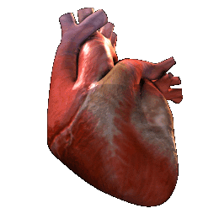
Cardiovascular Benefits ของการเลิกบุหรี่
Long-term Benefits
Reduced risk of
  Stroke
  Repeat CABG
  Recurrent coronary events after MI
  Arrhythmic death after MI
  Secondary CVD events
  Revascularization procedure after CABG
Reduced
  Mortality after CABG
  Mortality after PTCA
  Levels of inflammatory markers associated with progression of CVD
  (C-reactive protein, WBC, and fibrinogen)
Short-term Benefits
↓ fibrinogen concentration
↓ rate of fibrinogen synthesis
↓ WBCs
Improved HDL/LDL ratio
↓ risk of stroke
↑ HDL; decreased LDL
↓ arterial pressure
↓ HR
Improved arterial compliance
↓ risk of arrhythmic death after MI
↓ platelet volume
Enhanced platelet cAMP response to stimulation of ADP with prostaglandin E1
↓ smoking-induced platelet aggregability
Twardella et al. Eur Heart J. 2004;25:2101-2108; Morita et al. J Am Coll Cardiol. 2005;45:589-594; Oren et al. Angiology. 2006;57:564-568; Terres et al. Am J Med. 1994; 97:242-249; Nilsson et al. J Int Med. 1996; 240:189-194; Peters et al. J Am Coll Cardiol. 1995;26:1287-1292; Rea et al. Ann Intern Med. 2002;137: 494-500; Hasdai et al. N Engl J Med. 1997;336:755-761; van Domburg et al. J Am Coll Cardiol. 2000; 36:878-883; Bakhru et al. PLoS Med. 2005;2:e160; Eliasson et al. Nicotine Tob Res. 2001;3 :249-255; Hunter et al . Clin Sci. 2001;100 :459-465; Wannamethee et al. JAMA. 1995;274:155-160.
Notes:
Smoking cessation is associated with multiple short- and long-term cardiovascular benefits.
Twardella D, Kupper-Nybelen J, Rothenbacher D, Hahmann H, Wusten B, Brenner H. Short-term benefit of smoking cessation in patients with coronary heart disease: estimates based on self-reported smoking data and serum cotinine measurements. Eur Heart J. 2004;25(23):2101-2108.
Morita J, Ikeda H, Haramaki N, Eguchi H, Imasizumi T. Only two-week smoking cessation improves platelet aggregability and intraplatelet redox imbalance of long-term smokers. J Am Coll Cardiol. 2005;45(4):589-594.
Oren S, Isakov I, Golzman B, et al. The influence of smoking cessation on hemodynamics and arterial compliance. Angiology. 2006;57(5):564-568.
Terres W, Becker P, Rosenberg A. Changed in cardiovascular risk profile during the cessation of smoking. Am J Med. 1994;97:242-249.
Nilsson P, Lundgren H, Söderström M, Fagerström K-O, Nilsson-Ehle P. Effects of smoking cessation on insulin and cardiovascular risk factors—a controlled study of 4 months' duration.
J Intern Med. 1996;240(4):189-194.
Peters R, Brooks M, Todd L, Liebson P, Wilhelmsen L; The Cardiac Arrhythmia Suppression Trial (CAST) Investigators. Smoking cessation and arrhythmic death: the CAST experience. J Am Coll Cardiol. 1995;26:1287-1292.
Rea TD, Heckbert SP, Kaplan RC, Smith NL, Lemaitre RN, Psaty BM. Smoking status and risk for recurrent events after myocardial infarction. Ann Intern Med. 2002;137:494-500.
Hasdai D, Garratt K, Grill D, Lerman A, Holmes D. Effect of smoking status on the long-term outcome after successful percutaneous coronary revascularization. N Engl J Med. 1997;336:755-761
van Domburg RT, Meeter K, van Berkel DFM, Veldkamp RF, van Herwerden LA, Bogers JAJC. Smoking cessation reduces mortality after coronary artery bypass surgery: a 20-year follow-up study. J Am Coll Cardiol. 2000;36:878-883.
Bakhru A, Erlinger TP. Smoking cessation and cardiovascular disease risk factors: results from the Third National Health and Nutrition Examination Survey. PLos Med. 2005;2(6, e160):0528-0536.
Eliasson B, Hjalmarson A, Kruse E, Landfeldt B, Westin A. Effect of smoking reduction and cessation on cardiovascular risk factors. Nicotine Tob Res. 2001;3(3):249-255.
Hunter KA, Garlick PJ, Broom I, Anderson SE, McNurlan MA. Effects of smoking and abstention from smoking on fibrinogen synthesis in humans. Clin Sci (Lond). 2001;100(4):459-465.
Wannamethee G, Shaper AG, Whincup PW, Walker M. Smoking cessation and the risk of stroke in middle-aged men. JAMA. 1995;274:155-160.

Slide 31

ในเมื่อเรามีหัวใจเพียงคนละ 1 ดวง
รักหัวใจ
รักษ์หัวใจ
อย่าสูบบุหรี่
เลิกสูบโดยเด็ดขาด ตั้งแต่วันนี้
หนีให้ห่างจากควันมือสอง
ไม่ยอมรับควันบุหรี่มือสองในที่ทำงาน
สถานที่ทำงานปลอดบุหรี่
ออกกำลังกาย
อาหาร & อารมณ์

Slide 32
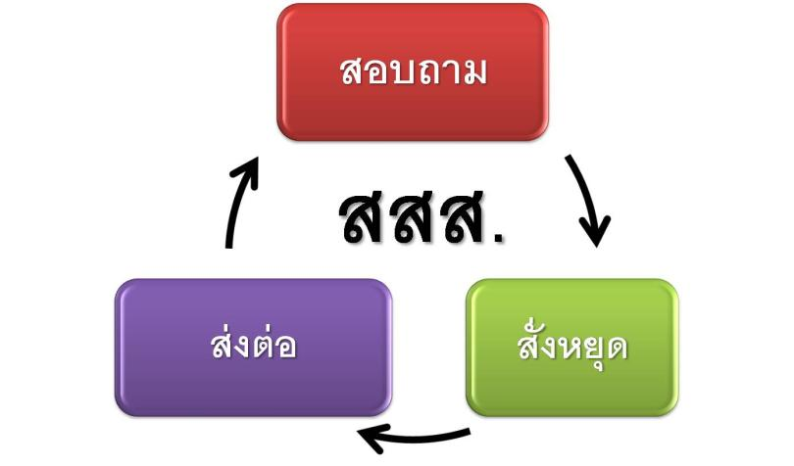
ในฐานะบุคลากร จะทำอย่างไรดี

Slide 33

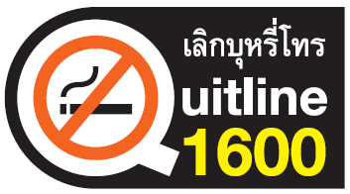

Refer
ส่งต่อ

Slide 34


Take Home
บุหรี่มีผลกระทบต่อหัวใจและหลอดเลือดโดยตรง ทั้งทางตรงและทางอ้อม
ไม่ว่าจะเป็นการสูบบุหรี่โดยตรง หรือควันบุหรี่มือสอง ล้วนมีผลต่อการเกิดโรคหัวใจและหลอดเลือดทั้งสิ้น
การเลิกบุหรี่เป็นหนทางเดียวที่จะลดความเสี่ยงเหล่านี้ได้
หากรักษ์หัวใจจริง ต้องไม่สูบบุหรี่และไม่รับควันมือสอง
สถานที่ทำงานทุกแห่งควรปลอดบุหรี่

Slide 35


ขอบคุณครับ

